Slide 1
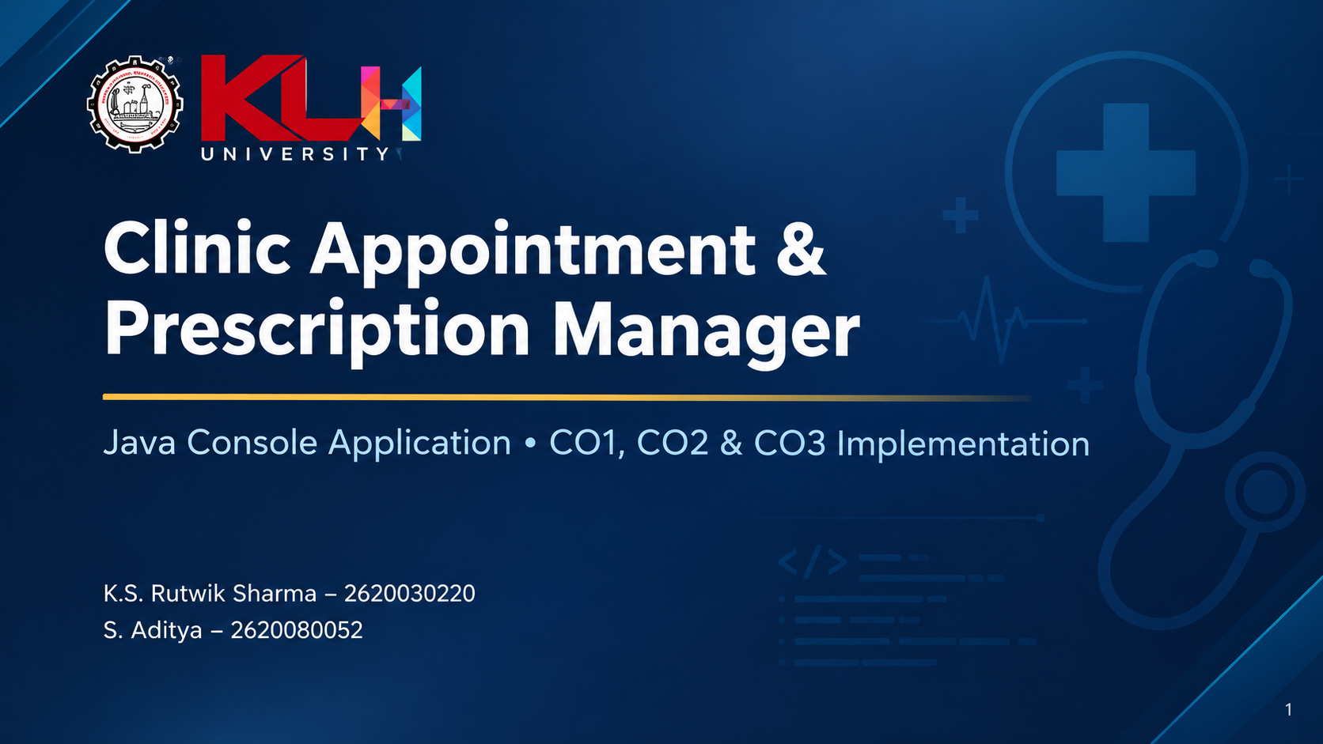

Slide 2

Abstract
The Clinic Appointment & Prescription Manager is a Java console application for daily clinic activities.
It manages doctor registration, patient registration, appointment booking, prescription management, and patient history.
The system replaces manual paperwork with a structured process and helps prevent appointment conflicts.
The implementation demonstrates the required Java concepts through variables, control statements, methods, and arrays.
2

Slide 3
Understanding the Problem Statement
Paper-based clinic records can lead to double-bookings, misplaced prescription information, and difficult history tracking.
A single console system is needed to register doctors and patients, schedule appointments, and retrieve visit history.
The application validates entries before performing operations.
Goal: provide a simple, structured Java solution for common clinic management tasks.
3

Slide 4
CO1 Topics
Java fundamentals used in the clinic application
Variables — store doctor IDs, patient IDs, names, fees, dates and other values.
Data types — int, double, boolean and String.
Constants — final variables for fixed limits or values.
Literals — numeric, string and boolean literal values used in the program.
Operators — arithmetic, relational, logical and assignment operators.
Typecasting — converting values when calculations require a different type.
4

Slide 5
CO2 Topics
Decision-making and repetition
Conditional statements: if, if-else, nested if and if-else-if ladder.
switch with default and break for menu-based clinic operations.
Loops: for, while and do-while for repeated processing.
Compound statements: multiple statements grouped inside { }.
Nested loops: one loop inside another, useful for processing a 2D schedule.
6

Slide 6
CO3 Topics
Methods and array-based data processing
Methods — divide the application into reusable tasks.
Parameter passing — send IDs, arrays and values into methods.
Return values — methods return search results, sums, averages or boolean results.
Method overloading — same method name with different parameter lists.
Recursion — a method calls itself with a smaller input.
1D arrays — store a sequence such as patient IDs.
2D arrays — represent rows and columns such as appointment slots.
Searching, summation, average and counting — standard array-processing operations.
9

Slide 7
CO4 Topics
Classes, objects, relationships and exception handling
Classes and objects — model clinic entities such as Doctor, Patient and Appointment.
Encapsulation — keep data private and access it through public methods.
Relationships — an Appointment connects a patient with a doctor.
Problem-domain model — represent clinic activities using suitable classes and objects.
Exception handling — use try, catch and finally to handle invalid input or runtime errors.
Example: an Appointment object stores appointment details and validates its data.
12

Slide 8
CO5 Topics
String processing, algorithms and file input/output
String API — use methods such as length(), equals(), contains() and compareTo().
StringBuilder — build or update text efficiently, such as a patient history summary.
Searching — locate a patient or appointment by ID or name.
Sorting and comparison — arrange records by patient name, ID or appointment date.
File input/output — use file classes/readers/writers to save and load clinic records.
Example: search a patient name, sort the results, and save a report to a file.
13

Slide 9
CO6 Topics
Collections, lambdas, functional interfaces and streams
Collections — use ArrayList or other collection types to manage doctors, patients and appointments.
Lambda expressions — write short actions for sorting or filtering records.
Functional interfaces — use interfaces such as Predicate or Comparator with lambda expressions.
Stream pipelines — process records with operations such as filter(), sorted() and forEach().
Declarative processing — describe what records to select or display instead of writing every loop.
Example: filter appointments for one doctor, sort them by date, and display the results.
14

Slide 10
Application Flow & Sample Operations
1. Register a doctor and store the doctor ID and name.
2. Register a patient and store the patient ID and name.
3. Validate IDs before booking an appointment.
4. Check the selected appointment slot and prevent a conflicting booking.
5. Display patient history and appointment status.
6. Cancel an appointment when required.
15

Slide 11
Conclusion
Developed a Java-based Clinic Appointment & Prescription Manager.
Simplifies doctor and patient registration, appointment booking, and prescription management.
Reduces manual paperwork and helps prevent appointment conflicts.
Demonstrates Java concepts from CO1 to CO6, including OOP, exception handling, file handling, and collections.
Provides a foundation for a more efficient and organized clinic management system.
16

Slide 12
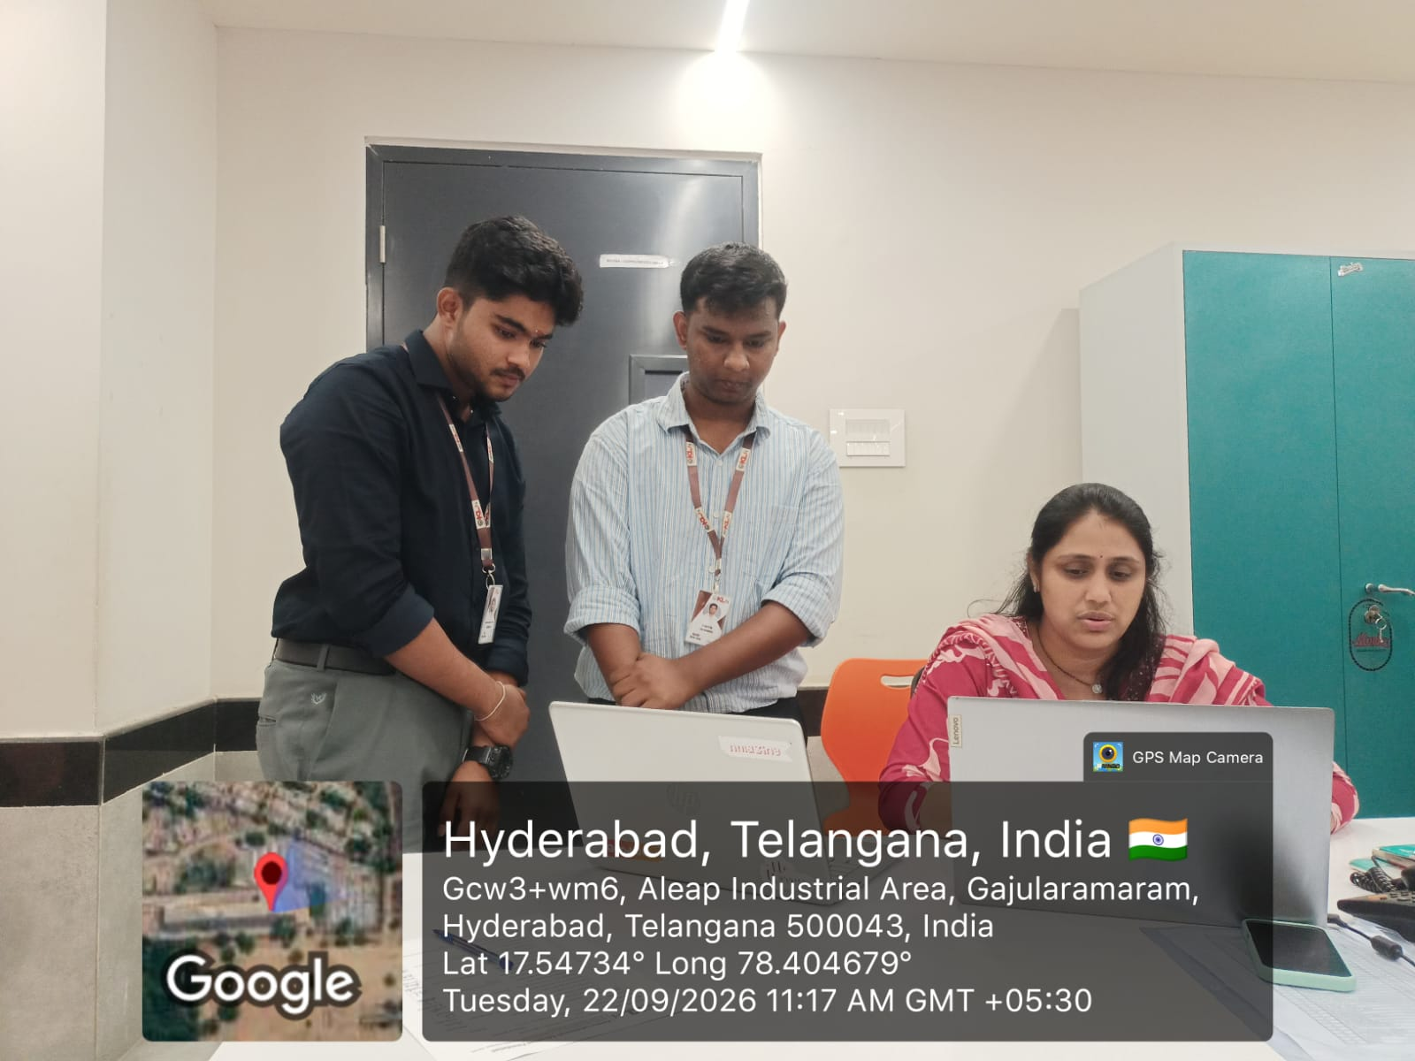
GitHub Link & Geo-Tagged Photo
GitHub Repository:
S. Aditya = SAdit-y-a · GitHub
K.S. Rutwik Sharma = https://github.com/krishnashastrularutwiksharma/Clinic-Appointment-Prescription-Manager-Team--8
Geo-Tagged Photo:
  Add a location-stamped team photo here.
17

Slide 13


